Slide 1
Sprint Meeting Presentation
Andrew Pokley, Jayden Slaughter, Connor Roberts

Slide 2
Overview
Software system that helps customers decide what kind of car they should buy based on multiple criteria
Helps customers and dealerships get an idea of what the customer is interested in
Should result in easier decision making for the customer and more accurate suggestions from the dealer
Will save time when first deciding what car to buy

Slide 3
Each Member’s Involvement
01
Andrew: Helped brainstorm initial idea for project. Helped research and create website for the software
02
Jayden: Brainstormed initial idea for project. Collected car database requirements
03
Connor: Helped Brainstorm the initial idea for the project. Looked on how to create a code for our project/website

Slide 4
Essential Tools and Techniques for Development
Agile
Scrum(sprints)
Kanban Board

Slide 5
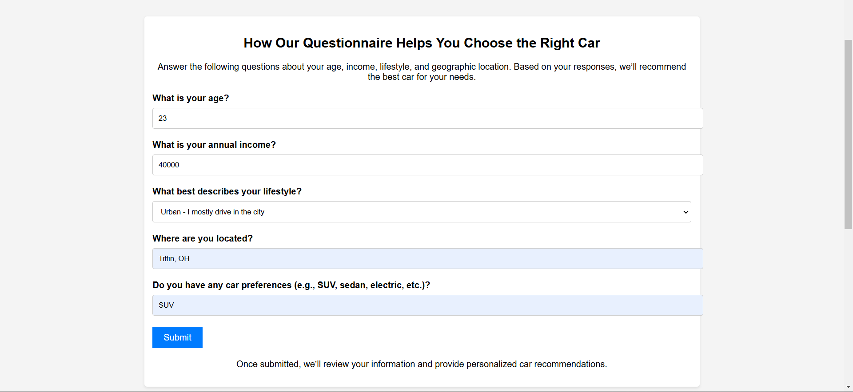
Prototype
file:///C:/Users/andre/OneDrive/Documents/car-dealership.html#contact

Slide 6
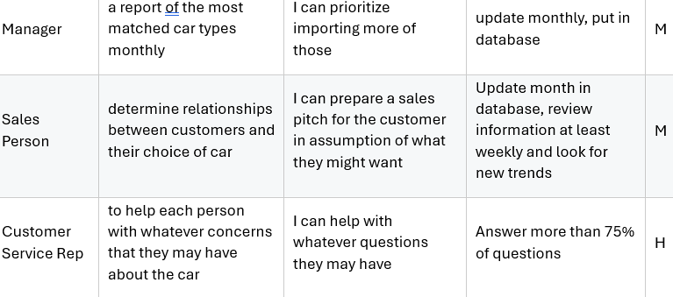
Main components, ERD, and examples of User Stories
Components: Car Database, User Survey, Car-Match Algorithm
ERDS: User- entity, Car - entity, Archetype - entity
Each user must be assigned to at least one archetype.
Each archetype can be assigned to more than one user.
Each car can only be assigned to one archetype.

